Slide 1
Cities, Mass Culture, Migration, and the 20s
“Where there’s smoke, there’s fire” (192?)

Slide 2
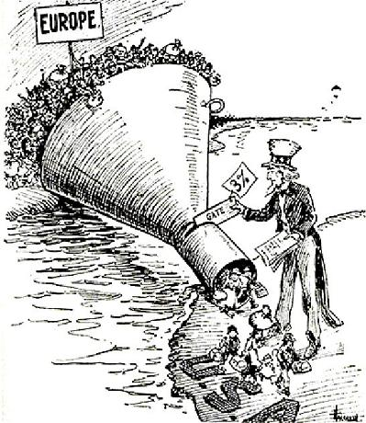
Post WWI
In the years following World War I, the United States pursued a unilateral foreign policy that used international investment, peace treaties, and select military intervention to promote a vision of international order, even while maintaining U.S. isolationism.
For example, the US fails to join the League of Nations (that were suggested by President Wilson)
This leads to an era where the US has a jump in cultural developments

Slide 3
New Technologies and manufacturing techniques helped the US economy on the production of consumer goods, contributing to improved standards of living, greater personal mobility, and better communication systems
More consumer goods/higher standards of living | US Steel Company (1901) Taylorism (Scientific management) Ford’s moving assembly line Increased consumer goods industry (electric washing machines, vacuums, refrigerators, etc.)
Greater personal mobility | Henry Ford’s Model T car (1908) General Motors (1908)
Better communication systems | First Radio newscast – Detroit (1920) Radio broadcasts of sporting events and entertainment shows begins in the 1920s

Slide 4
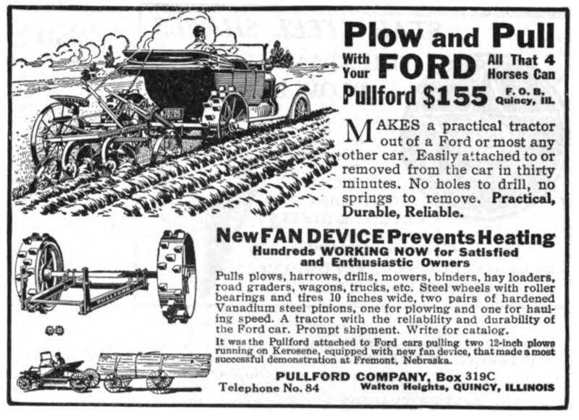

Slide 5
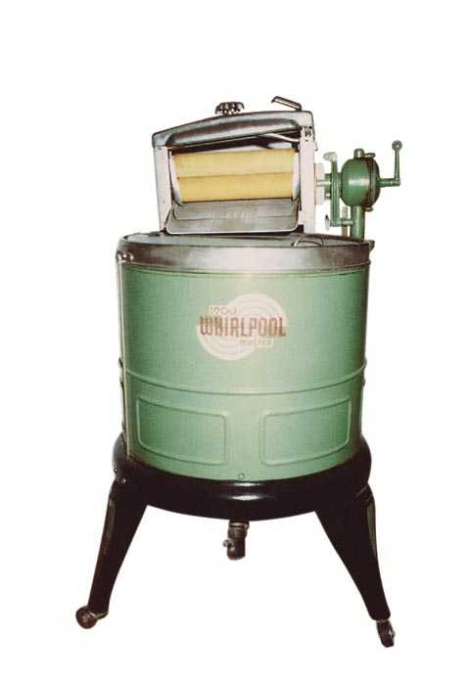
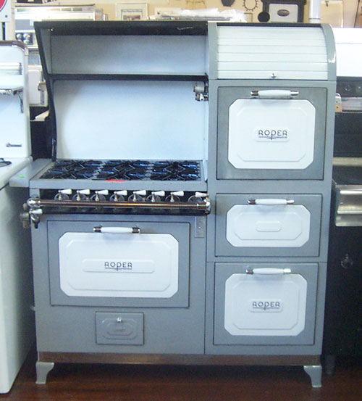
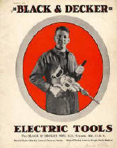
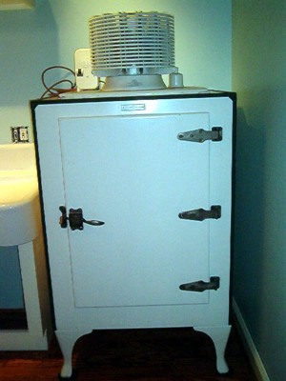
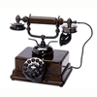
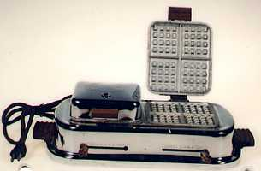
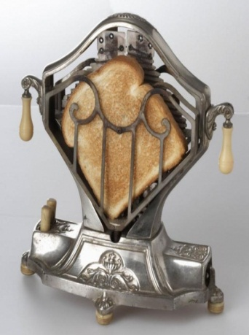
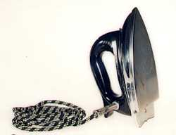
Consumer Economy

Slide 6
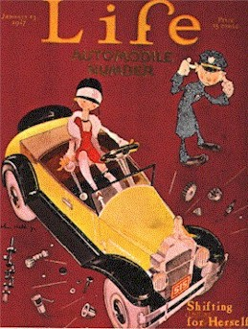
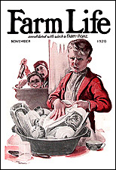
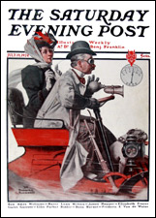
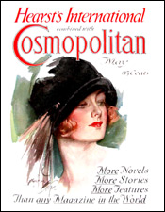
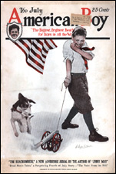
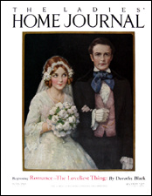
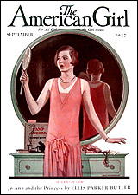
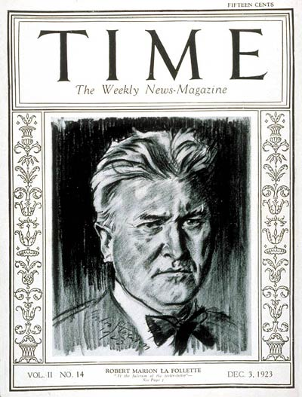
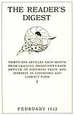
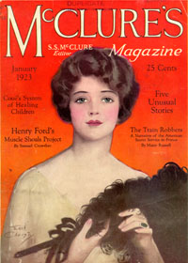
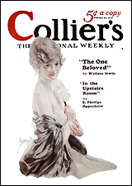
Expanding News Coverage
As literacy increased, newspaper circulation increased and mass-circulation magazines flourished.
By the end of the 1920s, ten American magazines (including Reader’s Digest and Time) boasted circulations of over two million.

Slide 7
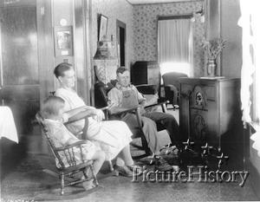
Mass Culture
Radio
Movies
(Above, lines outside a movie theatre)
(Left, family listening to the radio)

Slide 8
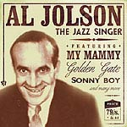
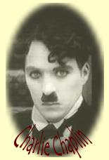
The Movies
Even before sound, movies offered a means of escape through romance and comedy.
The first sound movie was the Jazz Singer (1927)
The first animation with sound was Steamboat Willie (1928).
By 1930, millions of Americans went to the movies every week.
Wizard of Oz first color movie (1939)
Walt Disney's animated Steamboat Willie marked the debut of Mickey Mouse. It was a seven minute long black and white cartoon.

Slide 9
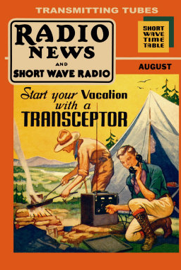
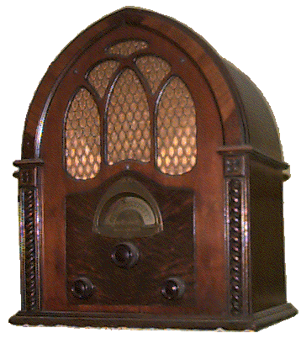
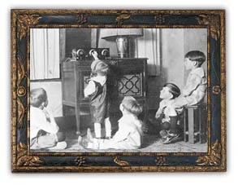
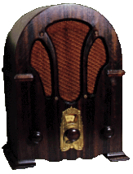
Radio Comes Of Age
Radio was even more popular than newspapers, magazines, or movies.
News was delivered faster and to a larger audience via radio.
Americans could finally hear the voice of the President or listen to the World Series live.
The Jazz Age

Slide 10
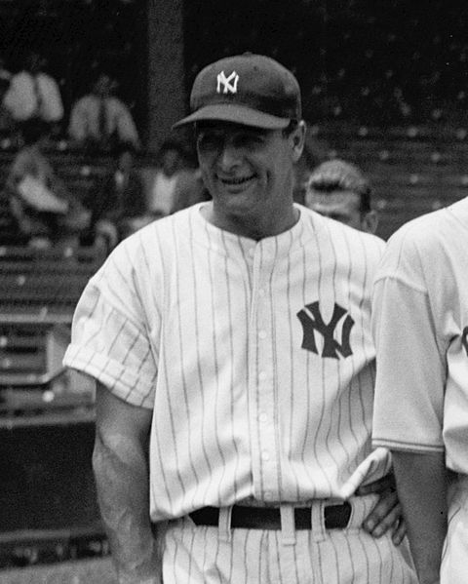
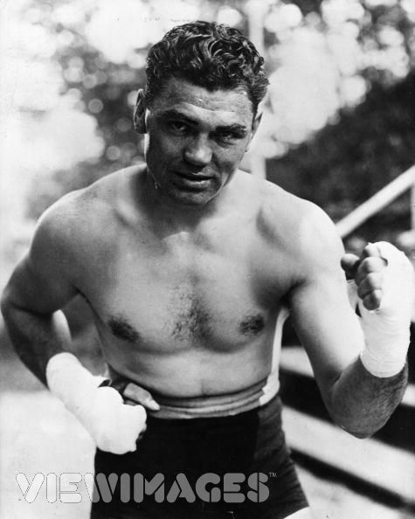
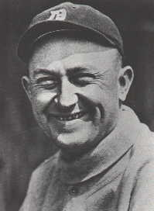
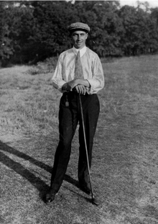
American Heroes
In 1929, Americans spent $4.5 billion on entertainment (including sports).
People crowded into sporting events to see their heroes.

Slide 11
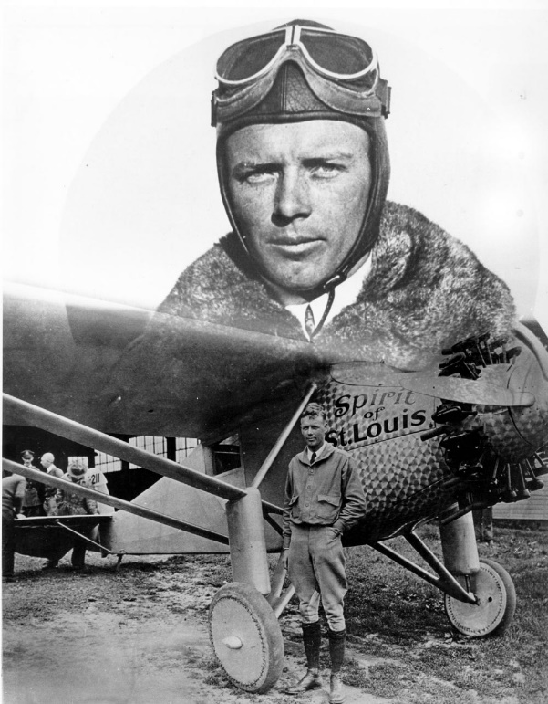
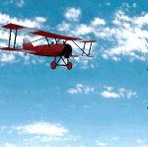
Lindbergh’s Flight
America’s most beloved hero of the 1920s wasn’t an athlete but a small-town pilot named Charles Lindbergh.
Lindbergh made the first nonstop solo trans-Atlantic flight.
He took off from NYC in the Spirit of St. Louis and arrived in Paris 33 hours later to a hero’s welcome.

Slide 12
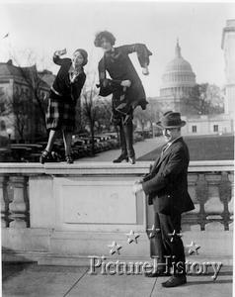
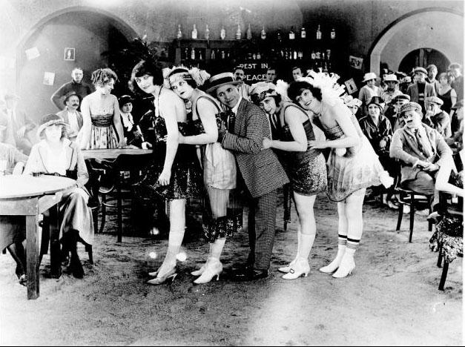
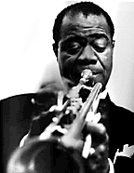
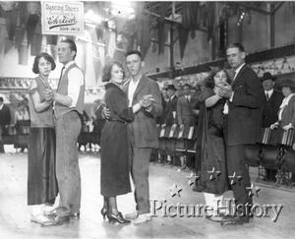
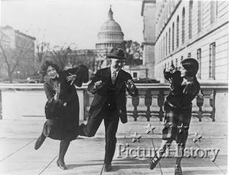
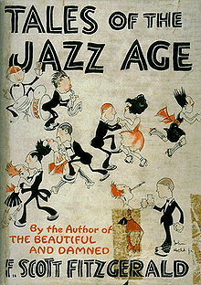
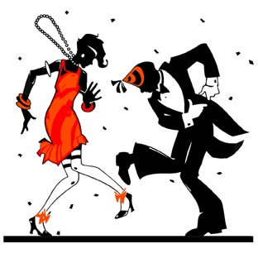
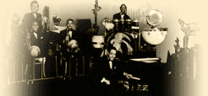
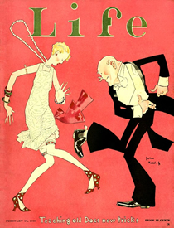
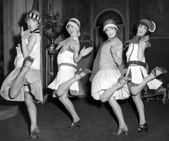
The Jazz Age

Slide 13
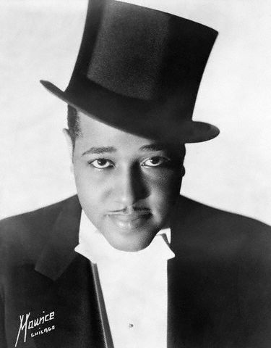
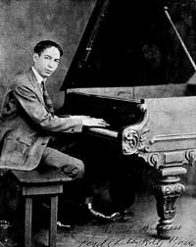
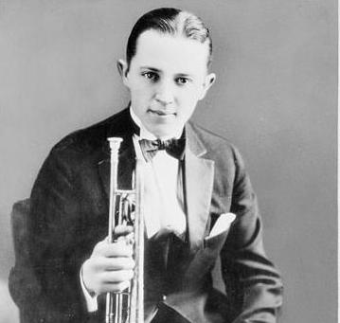
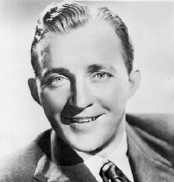
The Jazz Age
Jazz, despite competition with classical music, rose in popularity and helped to generate a cultural shift.
Dances like the Charleston, developed by African Americans, suddenly became popular among younger demographics.
With the beginning of large-scale radio broadcasts in 1922, Americans were able to experience different styles of music without physically visiting a jazz club.
The radio provided Americans with a trendy new avenue for exploring the world through broadcasts and concerts from the comfort of their living room

Slide 14
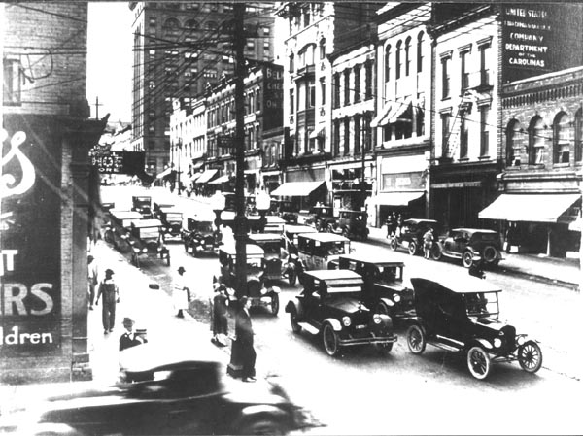
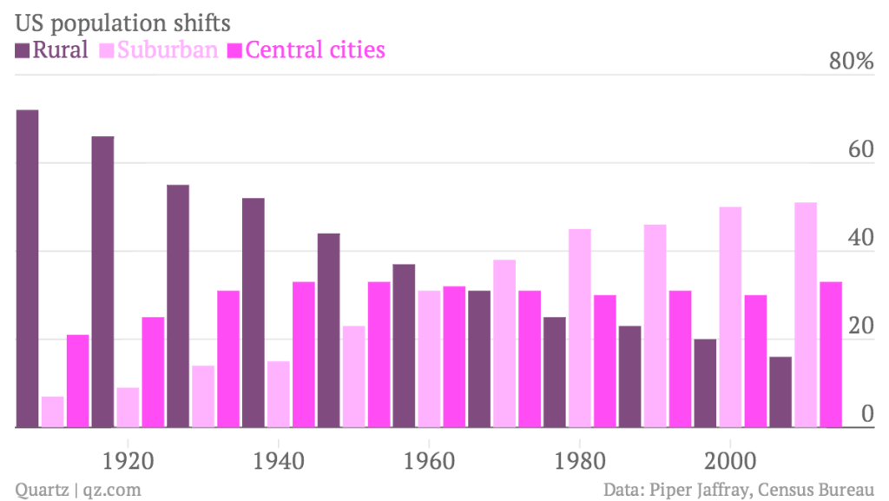
Moving to the Cities
By 1920, a majority of the U.S. population lived in urban centers, which offered new economic opportunities for women, international migrants, and internal migrants.
- The Great Migration (more next class)
- Factories in cities provide jobs (Triangle Shirt-waist)

Slide 15
Clash Between Old and New
In the 1920s, cultural and political controversies emerged as Americans debated gender roles, modernism, science, religion, and issues related to race and immigration.
Flappers
fundamentalism vs. modernism, Scopes “Monkey” Trial (1925)

Slide 16
Scopes Monkey Trial aka State of Tennessee vs. John Scopes
TN Butler Act – Illegal to teach evolution in a state-funded school
John Scopes (substitute) was set up and self incriminated in order to bring case to trial
Scopes represented by famous attorney Clarence Darrow, Prosecution for TN was….wait for it….William Jennings Bryan

Slide 17
Fundamentalist Revolt
Prohibition, 1920
KKK Marches in DC, 1925

Slide 18
https://www.youtube.com/watch?v=VfOR1XCMf7A&list=PL8dPuuaLjXtMwmepBjTSG593eG7ObzO7s&index=33

Slide 19
Interwar Period Day 2 Women, African Americans, Hispanics, Immigration

Slide 20
Changing Role of Women
19th Amendment (1919)
Changes in divorce laws – divorce rate doubles in the 1920s
Flappers smoke and drink in public, sexually more liberal
While women see some more freedom, many, such as the man above, still inforce more traditional roles/values/dress/etc.

Slide 21
Why I Bobbed My Hair
Mary Garden, famous Scottish opera singer with hugely successful American career
Mary Pickford, Canadian-American film actress

Slide 22
African Americans
Life in the South:
Strange Fruit by Billie Holiday (1939)
https://www.youtube.com/watch?v=h4ZyuULy9zs
In a Great Migration during and after World War I, African Americans escaping segregation, racial violence, and limited economic opportunity in the South moved to the North and West, where they found new opportunities but still encountered discrimination.
Kanye West Blood on the Leaves, 2013

Slide 25
The Great Migration
Jacob Lawrence Migration Series, 1940
http://www.moma.org/interactives/exhibitions/2015/onewayticket/panel/1/intro

Slide 26
The Great Migration
Black families & young men moved north to take advantage of booming wartime industry
Black neighborhoods began to form within these a distinct Black culture flourished
But both blacks and whites wanted cultural interchange restricted

Slide 28
The Harlem Renaissance
Between 1910 and 1920, the Great Migration saw hundreds of thousands of African Americans move north to big cities. By 1920, over 5 million of the nation’s 12 million African Americans (over 40%) lived in cities.

Slide 29
The Harlem Renaissance
Harlem, NY became the largest black urban community.
Harlem suffered from overcrowding, unemployment and poverty.
However, in the 1920s, it was home to a literary and artistic revival known as the Harlem Renaissance.
Black artists, musicians, and writers celebrated their African and American heritage.

Slide 30
Progress
Founded in 1909, the NAACP urged African Americans to protest racial violence
W.E.B Dubois, a founding member, led a march of 10,000 black men in NY to protest violence.
The National Association for the Advancement of Colored People, usually abbreviated as NAACP, is an African-American civil rights organization.
Its mission is "to ensure the political, educational, social, and economic equality of rights of all persons and to eliminate racial hatred and racial discrimination".

Slide 31
Marcus Garvey
In 1914, Garvey founded the Universal Negro Improvement Association (UNIA) and attracted a million members by the mid-1920s.
He left a powerful legacy of black pride, economic independence, and Pan-Africanism. Marcus Garvey believed that African Americans should build a separate society in Africa.
If you have no confidence in self, you are twice defeated in the race of life. With confidence, you have won even before you have started. – M. Garvey

Slide 32
Pan-Africanism
Garvey called for individuals of African descent to return to the continent.
A movement that seeks to unify African people or people living in Africa, into a "one African community." Differing types of Pan-Africanism seeks different levels of ; economic, racial, social, or political unity.

Slide 35
African American Writers
The Harlem Renaissance included a literary movement led by well-educated blacks with a new sense of pride in the African-American experience. Claude McKay’s works expressed the pain and frustration of life in the ghetto.

Slide 36
Zora Neale Hurston
Wrote novels & short stories
Traveled throughout the South collecting folk tales, songs, and prayers of black southerners
Published these in her book, “Mules and Men”
Of Hurston's four novels and more than 50 published short stories, plays, and essays, she is best known for her 1937 novel Their Eyes Were Watching God

Slide 37
Langston Hughes
Most well-known of the Harlem Renaissance poets
Also wrote plays, short stories, and essays
First poem, “The Negro Speaks of Rivers”
Encouraged African Americans to be proud of their heritage
Protested racism and acts of violence against blacks
Born in Joplin, raised in Lawrence by his grandmother.
From ELA: Harlem, Let America be America Again, The Word Black

Slide 38
Immigration Issues
Immigration from Europe reached its peak in the years before World War I. During and after World War I, nativist campaigns against some ethnic groups led to the passage of quotas that restricted immigration, particularly from southern and eastern Europe, and increased barriers to Asian immigration.
Immigration Act of 1917 - restricted the immigration of 'undesirables' from other countries, including "idiots, imbeciles, epileptics, alcoholics, poor, criminals, beggars, any person suffering attacks of insanity, those with tuberculosis, and those who have any form of dangerous contagious disease, aliens who have a physical disability that will restrict them from earning a living in the United States..., polygamists and anarchists, those who were against the organized government or those who advocated the unlawful destruction of property and those who advocated the unlawful assault of killing of any officer."
Emergency Quota Act of 1921 - The objective of this act was to temporarily limit the numbers of immigrants to the United States by imposing quotas based on country of birth. Annual allowable quotas for each country of origin were calculated at 3 percent of the total number of foreign-born persons from that country recorded in the 1910 United States Census.
National Origins Immigration Act of 1924 – next slide ☺
Palmer Raids/ Red Scare - The Palmer Raids were a series of raids by the United States Department of Justice intended to capture, arrest and deport radical leftists, especially anarchists, from the United States. The raids and arrests occurred in November 1919 and January 1920 under the leadership of Attorney General A. Mitchell Palmer.
Freedom of Speech Restrictions / Schenck v. US (1919) – Espionage Acts of 1917 – Court said Espionage acts were legal

Slide 39
Immigration Acts/Quotas
In examining the table, who we trying to keep out and who were we wanting to bring in?

Slide 40
Mexican Americans
Mexican American Repatriation - During the Great Depression about a million Mexicans we ‘returned’ to Mexico because they post a competition for jobs against ‘Americans.” Recent historical evidence suggests that as many as 60% of those ‘repatriated’ were actually American citizens.
WWII Braceros Program – Ironically, during WWII, over a million Mexican American workers were invited to work in the US mostly as short term agricultural workers (we needed men to work as many of Americans were drafted)
Many Americans treated workers by spraying them with DDT (now an illegal pesticide) which was meant to rid them of diseases…FYI it doesn’t
http://www.npr.org/2015/09/10/439114563/americas-forgotten-history-of-mexican-american-repatriation

Slide 41
Sacco and Vanzetti – Guilty or Scape Goats??
Italian-born, open Anarchists
Accused of robbery and murder based on what many to believed as limited evidence
Their trial made national news as some believed them to be wrongfully accused due to their ethnicity and political views
Sentenced to death in 1921
(later forensic evidence has proved that the gun found on Sacco was used in the murder)
http://www.travelchannel.com/shows/mysteries-at-the-museum/video/sacco-and-vanzetti-innocent

