Slide 1
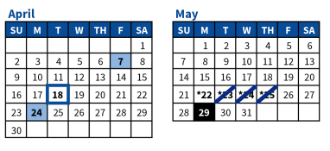
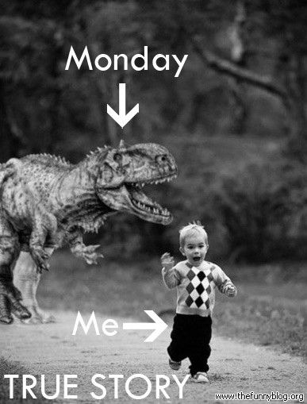
But first…Logistics
Today is April 10
Period 8-9 Test Next Week!
MC and DBQ
Your AP test is May 5 @ 8:00 am KU Edwards Campus (you will pre-register over the next few weeks w/ Mr. Stone.)
JAG review sessions: We only have 3 more.
4/11 – Period 3-4
4/18 – Period 5-6
After School sessions:
Thursday April 20 @ 6:00pm
Thursday April 27 @ 6:00pm
Practice Test April 29/30?????

Slide 2
Period 9
As the United States transitioned to a new century filled with challenges and possibilities, it experienced renewed ideological and cultural debates, sought to redefine its foreign policy, and adapted to economic globalization and revolutionary changes in science and technology.
1980 – Present
Complete your Period 9 concept outline as we move through this presentation
Warning *** Your APUSH teachers were born in this era…you were born in this era. Historians are not yet sure how to interpret this era. However, try to approach it through a historical lens and not as a debate on current events.
Things that may seem like a big deal to us today may not make the history books, but a court case that no one talked about may have a huge future impact that will be studied for generations. We do not yet have the advantage of hindsight.

Slide 3
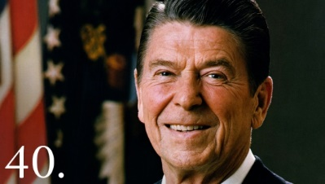
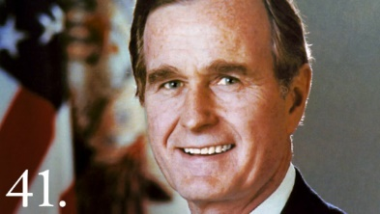
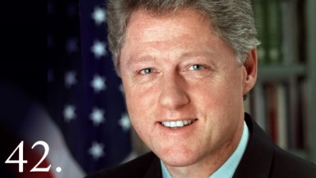
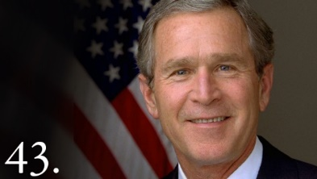
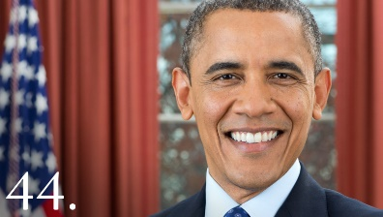
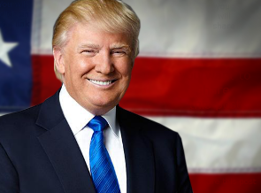
A Conservative Revolution? Period 9 Timeline
Republican
1980-1988
Republican
1988-1992
Republican
2000-2008
Republican
2016-Present
Democrat
1992-2000
(although passes Don’t Ask Don’t Tell and Has a balanced budget, passes welfare reform and repeals Glass-Steagall Act)
Democrat
2008-2016
Still unclear if Obama election of 2008 marks a shift away from conservative politics…
Ted Cruz is very different from Hillary…
THIS IS WHAT I SAID IN 2016
Why would America after supporting predominately Democrats (FDR, JFK, LBJ, Carter) shift to supporting Republicans/conservative Democrats?

Slide 4
Framework:
Key Concept 9.1: A newly ascendant conservative movement achieved several political and policy goals during the 1980s and continued to strongly influence public discourse in the following decades.
I. Conservative beliefs regarding the need for traditional social values and a reduced role for government advanced in U.S. politics after 1980.

Slide 5
Framework:
A) Ronald Reagan’s victory in the presidential election of 1980 represented an important milestone, allowing conservatives to enact significant tax cuts and continue the deregulation of many industries.
B) Conservatives argued that liberal programs were counterproductive in fighting poverty and stimulating economic growth. Some of their efforts to reduce the size and scope of government met with inertia and liberal opposition, as many programs remained popular with voters.
C) Policy debates continued over free-trade agreements, the scope of the government social safety net, and calls to reform the U.S. financial system.

Slide 6
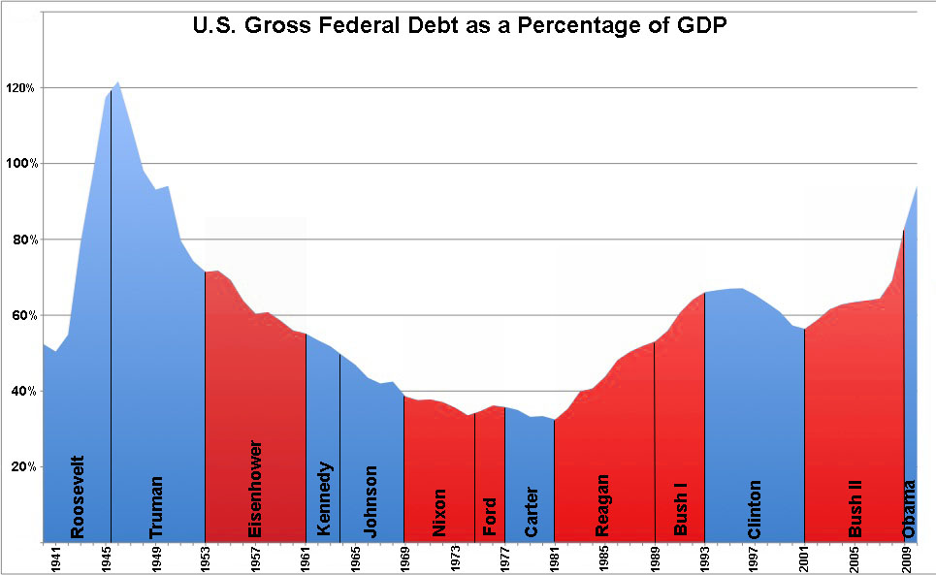
Post New Deal Republicanism
Seeks to deregulate the economy and reduce the size of government in order to spur economic growth
Was Regan a successful conservative? Jury is still out. Did not decrease deficit or shrink the size/role of government.

Slide 7
What would make people want to support less government?
Vietnam
Watergate
Growing distrust in big government
Antiauthority message in many protests from the 60s and 70s
Stagflation (high inflation and high unemployment) of the 1970s
Made people doubt Keynesian economics (countercyclical spending)
Many Americans sought the need for the US to reassert itself in the Cold War/world
Religious issues become a big deal: abortion (Roe v. Wade),
Regan’s conservative approach toward limiting the size and power of the federal government became very appealing to many voters.

Slide 8
Conservative issues: (a lot of this is at the end of the period 8 concept outline)
Taxpayers Revolt – 1978 – CA voters led revolt against increasing taxes by passing Prop. 13, a measure that cut property taxes. Nationally, conservatives promoted the ideas of the Laffer curve and the belief in Tax cuts (more later). Proposed legislation to reduce taxes by 30%, which Regan will support
Conservative Religious Revival – Lots of religious and TV leaders began talking about moral decay. People like Oral Roberts, Pat Robertson, etc. Televangelists had anywhere from 60-100 million viewers per week. People saw a ‘godless’ takeover of various parts of the US (public schools, Roe v. Wade, etc.) this sparks Catholics and some Protestants to more for pro-life campaigns, etc.
Elimination of Racial Preferences – LBJ had passed Affirmative Action. After suffering through stagflation, some whites based poor economic development on the requirement to hire minorities…Supreme Court case Regents of University of CA vs Bakke said that while race could be considered, racial quotas are unconstitutional.
De-Regulation of Business – Businesses pushed for less controlling and restrictive laws. Pretty successful campaign. Wanted to weaken labor unions, lower taxes, cut regulations, etc.

Slide 9
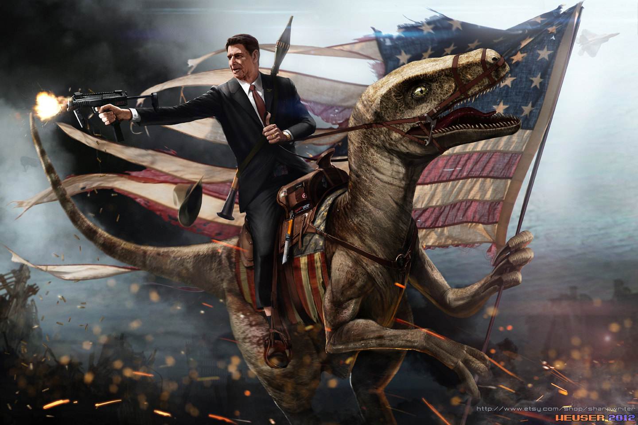
Election of Ronald Reagan
Real man vs Legend
Miller Center & American Experience

Slide 10
An intro to Ronald Reagan
Terminology:
Federalism – 10 Amendment- idea that some powers are reserved for the individual states (which means the US doesn’t use some power)
excise taxes -
Deregulation – the idea of removing some of the federal laws around what can and can’t be done (particularly with business)
budget deficit – when a country spends more than it takes in from taxes in a given year
private sector – business owned by individuals (vs government)
interlocking jurisdictions – as used in the State of the Union, is the idea that government overlaps and the idea of too much red tape to figure out which part of government is responsible for what

Slide 11
Answer the following from the 1982 State of the Union Address
What are the two economic problems Ronald Reagan discusses in the first paragraph that contributed to “a new kind of defeatism” felt by the American people?
List five actions Reagan says he has already taken to fix the problems of our nation.
What are the “four commonsense fundamentals” Reagan says will be the basis of his new plan?
How does Reagan feel about raising taxes?
Reagan wants to make our system of federalism work again. Describe what you think he means by this.
What is the problem Reagan suggests exists when the federal government controls the “essential services of government”?
How does Reagan suggest the power of government will be shared by 1988?
How does Reagan believe the private sector will help our nation?

Slide 12
Pick one of the following activities to complete after you read
Draw/create a mind-map or flow chart to summarize Reagan’s beliefs about federalism
Create a rap or rhyme that will help someone remember the concept of federalism
Review this definition of supply-side economics (you can search for your own definition online or supply multiple definitions): Supply-side economics, also known as trickle-down economics, is an economic theory that states that a reduction in taxes will stimulate the economy through increased consumer spending. Over time, the boost to economic growth will generate a larger tax base, which will make up for the revenue lost from the tax cut.
Write a paragraph where you agree or disagree with the statement: “Ronald Reagan was a supporter of Supply-side economics.” Was this the best economic theory for the 1980s? Why or why not?
Read Lyndon B. Johnson’s Great Society Speech (1964) and note his belief about the role the federal government should play to end poverty in the US.
Create a Venn diagram to compare the political and economic beliefs of Ronald Reagan and Lyndon B. Johnson.
Create a fifteen- to twenty-line dialogue between Ronald Reagan and Lyndon B. Johnson that portrays how each felt about the role of the federal government under our federal system. Include at least five specific ideas, concepts, programs, or examples for each president to demonstrate your knowledge.

Slide 13
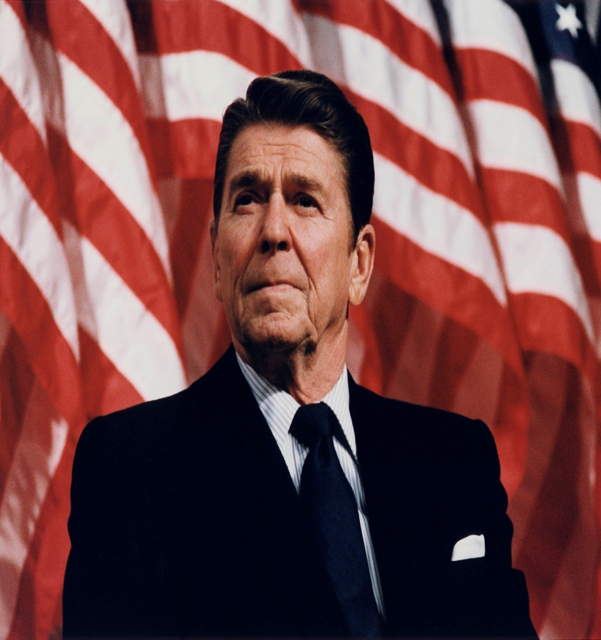
Ronald Reagan
Speech to National Association of Evangelicals: “Evil Empire” speech, March 10, 1983

Slide 14
Reagan’s Conservative Vision
Vietnam was a “Noble Cause”
Renew the Cold War
American Power
Patriotism
Traditionalism
State’s Rights
“Individualism”
Feel Good About America

Slide 15
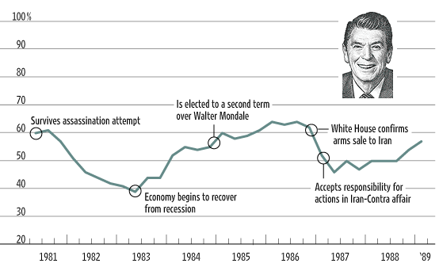
Reagan Public Approval Ratings

Slide 16
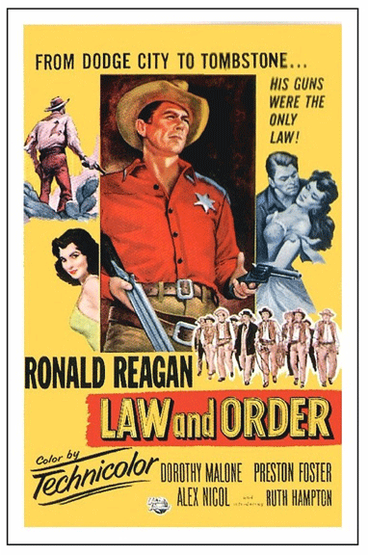
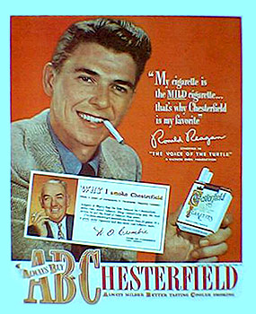
Before National Politics
Hollywood Actor in 1937; made 53 films
Goldwater speech 1964

Slide 17
“The Speech”
Reagan's televised 1964 "A Time for Choosing" speech on behalf of the Goldwater campaign propelled the actor from corporate spokesman to conservative champion.
Reagan outlined the goals of the modern conservative movement:
smaller government,
lower taxes,
personal autonomy,
more aggressive policy toward Communist states.
He implies that liberal policies represent a dangerous shift toward socialism, even drawing parallels between Lyndon Johnson and Karl Marx.

Slide 18
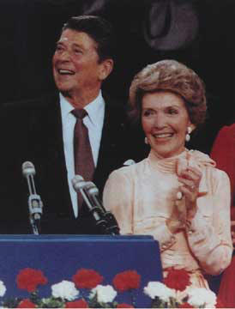
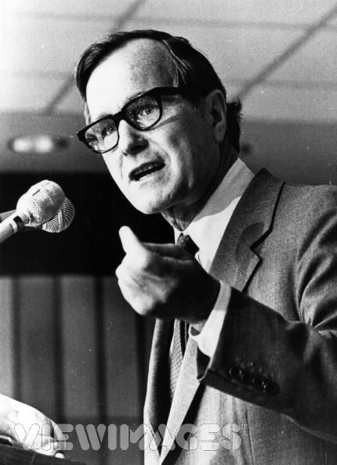
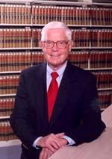
The Republican Nomination
The 50/50 Plan…
Republican as an Independent
Ron and Nancy GHW Bush John Anderson

Slide 19
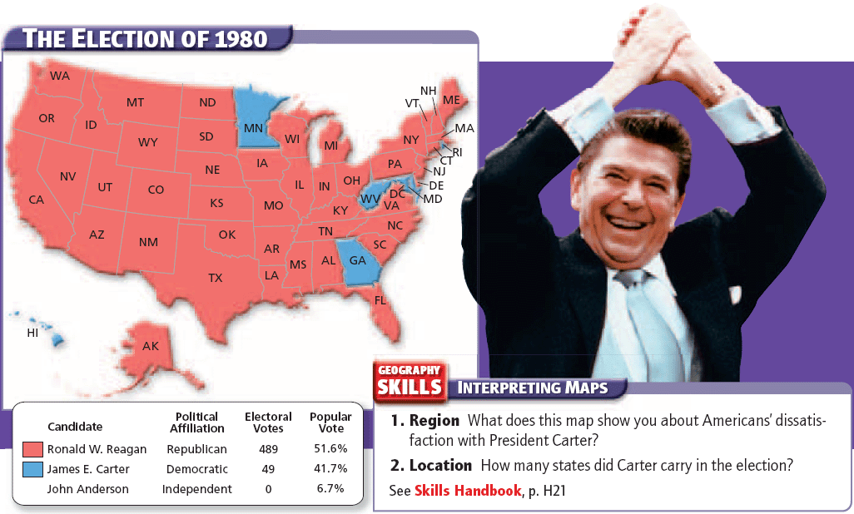
Regan finally breaks up the New Deal Coalition – about 50% of blue collar workers vote for him instead of Jimmy Carter.
Also in this election, Republicans take control of the Senate for the first time since the 1954 election.

Slide 20
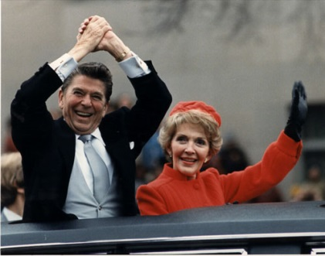
The Reagan Revolution and the First Inaugural Address
“In the days ahead I will propose removing the roadblocks that have slowed our economy and reduced productivity. Steps will be taken aimed at restoring the balance between various levels of government. Progress may be slow, measured in inches and feet, not miles, but we will progress. It is time to reawaken this industrial giant, to get government back within its means, and to lighten our punitive tax burden. And these will be our first priorities, and on these principles there will be no compromise.” - Ronald Reagan 1981

Slide 21
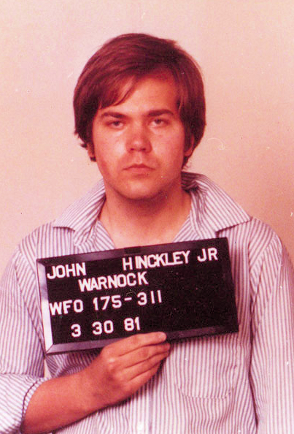
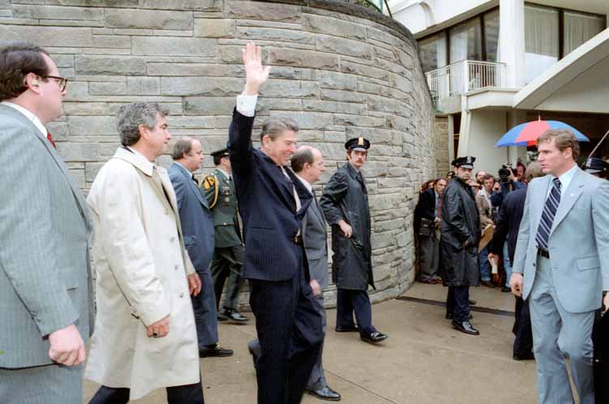
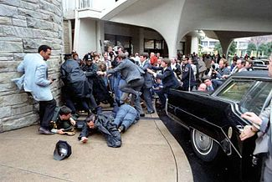
A Dramatic Start to the Reagan Presidency
Image grew stronger as he survived an assassination attempt on March 30, 1981 by John Hinckley Jr.

Slide 22
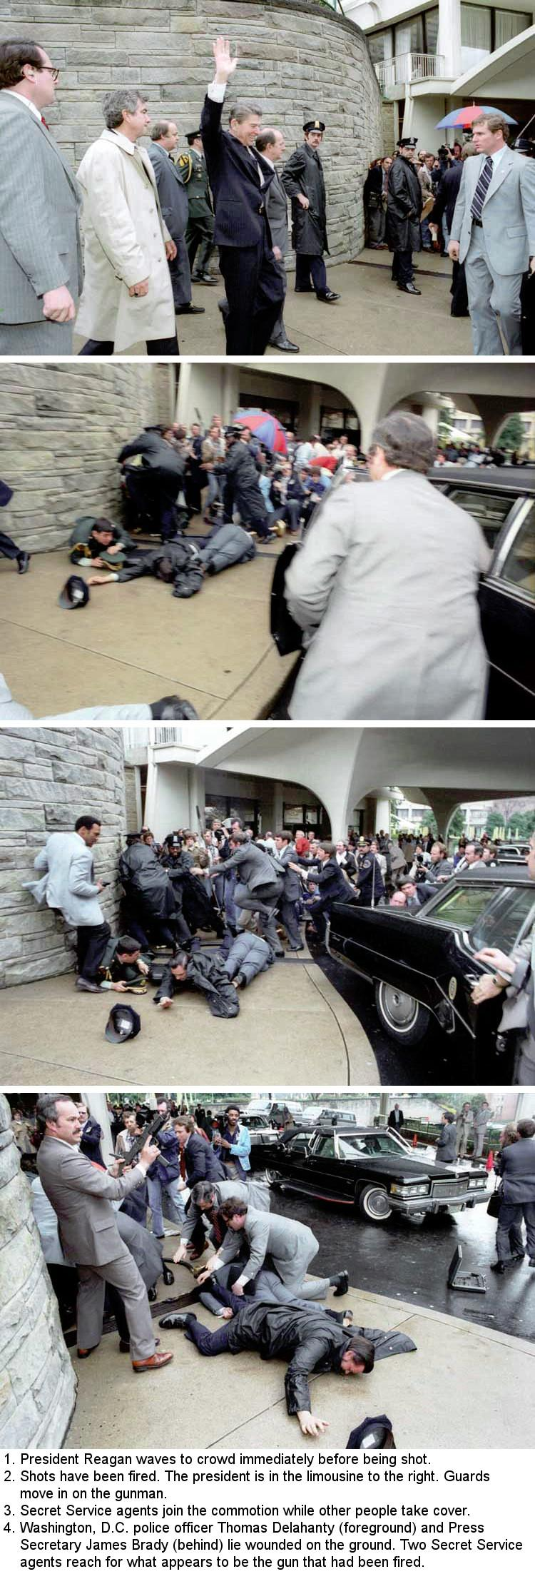
A Dramatic Start to the Reagan Presidency
On March 30, 1981, Reagan survived an assassination attempt by John Hinkley Jr, who shot the president in an effort to impress actress Jodie Foster. Reagan was more badly injured than the administration reported, but he remained optimistic and his approval rating reached 73%.

Slide 23
Reagan Public Approval Ratings

Slide 24
A Dramatic Start to the Reagan Presidency
In 1981, Reagan appointed the first female Supreme Court Justice Sandra Day O'Connor. Although she identified herself as a moderate Republican, foes of abortion and the ERA condemned her appointment to the bench.
Also appointed Antoinin Scalia, Anthony Kennedy, & Chief Justice William Rehnquist

Slide 25
9.1, I
B) Conservatives argued that liberal programs were counterproductive in fighting poverty and stimulating economic growth. Some of their efforts to reduce the size and scope of government met with inertia and liberal opposition, as many programs remained popular with voters.
C) Policy debates continued over free-trade agreements, the scope of the government social safety net, and calls to reform the U.S. financial system.

Slide 26
Reagan Policies
“Star Wars” speech, 1983
At Home
Supply-Side aka Reganomics – Trickle down theory
Federal Tax Reduction – 25% decrease in personal income tax over 3 years!!, cuts in corporate tax, capital gains tax, gift/inheritance tax (Economic Recovery Act of 1981)
Spending Cuts in Gov – Cut $40 billion from domestic programs like food stamps, student loans, public transportation…but, federal spending doesn’t actually go down, just replaced by military spending
Deregulation – eased restrictions on savings/loan institutions, relaxed mergers and takeovers by large corporations, relaxed environmental protection; relaxed regulation on auto emissions for US car manufacturers
Labor Unions – Ironic as he was the president of SAG; fired striking air traffic controllers and private sector followed his lead
Abroad (Cold War)
Major military build up – developed tons of new weapons like a B1 bomber, MX missile and expended the navy under the Strategic Defense Initiative (SDI) – aka Star Wars
Iran-Contra – US agreed to secretly sell antitank and anti aircraft missiles to Iran (who was fighting Iraq) in exchange for help with a hostage release…to make matters worse, Regan aids then used the money (illegally) to pay for military the US was having in Nicaragua. Investigations found the Regan didn’t know too much about it – made him look stupid
Tear Down this Wall…to be seen in later slides…

Slide 27
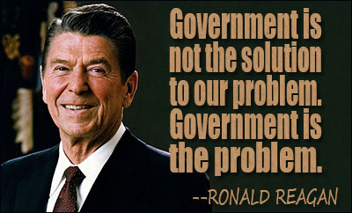
Measuring Regan’s success
So did he actually do this?
How much remained uncut?
Let’s see what the Amsco said…
President Regan’s two terms reduced restrictions on a free-market economy and put more money in the hands of investors and higher income Americans. Regan’s policies also succeeded in containing the growth of the New Deal-Great Society welfare state. Another legacy of the Regan years were the huge federal deficits of $200 and $300 billion a year, which changed the content of future political debates. With yearly deficits running between these figures, it no longer seemed reasonable for either Democrats or Republicans to propose new social programs, such as universal health coverage. Instead of asking what new government programs might be needed, Reganomics changed the debate to issues of which government programs to cut and by how much.

Slide 28
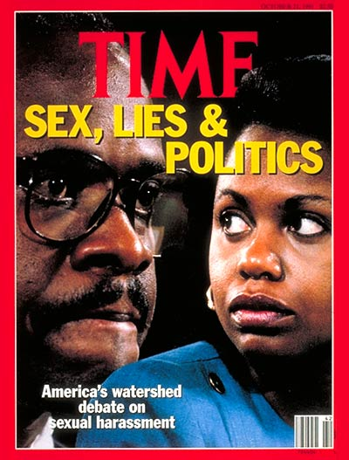
George HW Bush Policies
At Home
Abroad
Clarence Thomas nomination – to replace retiring Thurgood Marshall. Thomas had allegations of sexual harassment and was incredibly conservative in the way he ruled
Some Savings and Loan institutions (who had relaxed regulations thanks to Regan) needed to get bailed out to about $250 billion
Despite his campaign promise ‘no new taxes’ under HW Bush proposed billions in tax increases
Oversees end of the Cold War…on later slides…
Persian Gulf War…on later slides

Slide 29
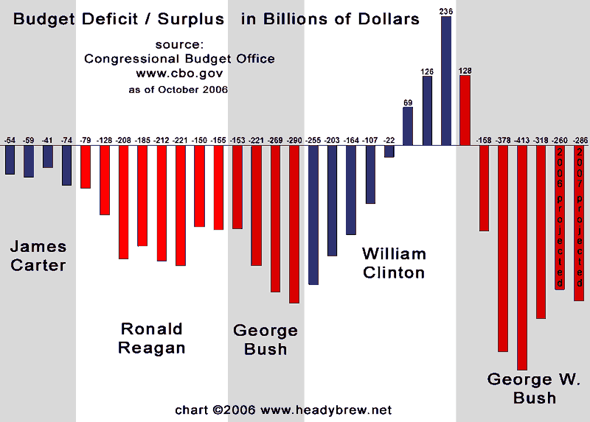
Clinton Policies Remember – the lone Democrat (besides Obama) of this period
At Home
Abroad
During WJC’s first term, he had a Democratic congress as well and passed some pretty liberal legislation for the era, such as the FMLA; the Bandy handgun bill that forced a 5 day wait period to purchase a gun; limited riffle sales angering the NRA
During his second term, Republicans take control of Congress (Newt=Speaker) which led to 2 government shutdowns
Only president to have a balanced budget
Don’t Ask Don’t Tell – Gay ‘privacy’ in the military
North American Free Trade Agreement – this also fits under other parts of framework –
NAFTA allows for free trade (no tariffs) between US, Canada, and Mexico
Balanced budget commentary: http://www.cato.org/publications/commentary/no-bill-clinton-didnt-balance-budget

Slide 30
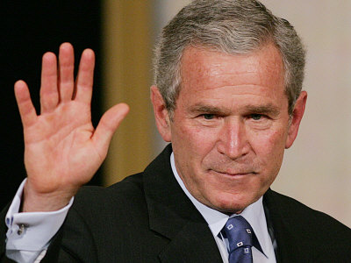
GW Bush
At Home
Abroad
Due to budget surplus, Congress cuts taxes $1.35 trillion
No Child Left Behind – education reform
Some major scandals involving business and corruption (Enron)
Sees the start of the Great Recession during last year or so in office
War on Terror…more on later slides

Slide 31
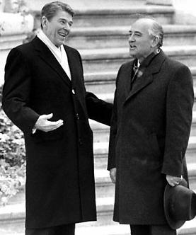
The cold war comes to a close

Slide 32
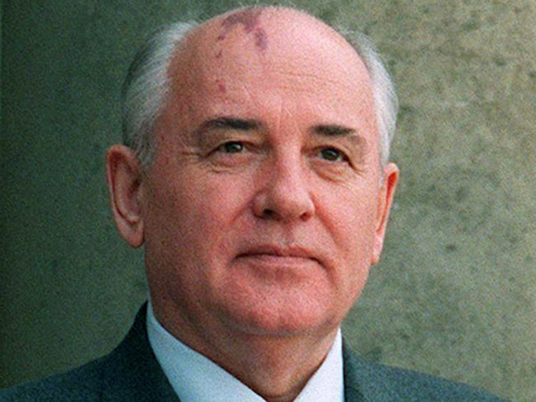
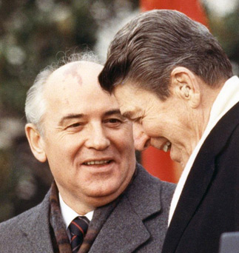
Regan’s Cold War
The guy who really was able to bring a close to the Cold War was not an American…
We already spoke about how Regan was anything but detente at the onset…see Star Wars
Change: USSR election of Mikhail Gorbachev
1) glasnost – openness to end political oppression, move toward grater political freedom
2) perestroika- to save the economy of the USSR, introducing some free-market industries
end (crazy expensive) arms race with US
Regan will travel to Berlin and challenge Gorbachev to follow through…super dramatic, very showy speech (again, he was a successful actor who knew how to entertain an audience)
FYI: Berlin wall actually torn down by protestors in Berlin
Gorbachev and Regan sign INF agreement to reduce intermediate range missiles
Gorbachev removes troops from Afghanistan (one of the major issues the US had)
The two become quite friendly and have multiple visits

Slide 33
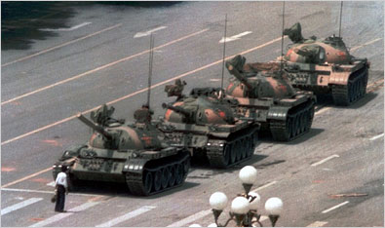
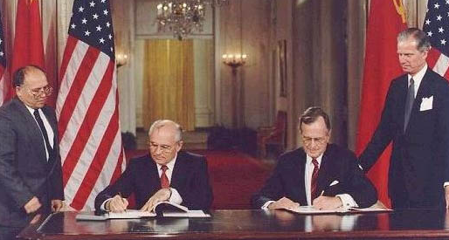
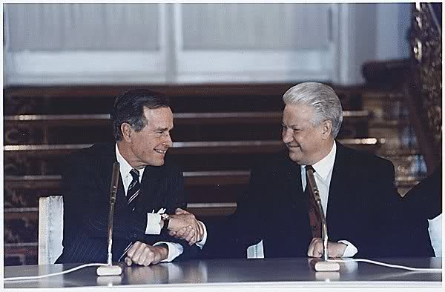
HW Bush’s Cold War
Soviet Union breaks up – see Tiananmen Square protests in China
1990 – some countries declare independence from USSR
1991 almost all of the republic dissolved
START 1 (1991) and START 2 (1992) – arms reduction treaties; agreement to dismantle nuclear weapons (by START 2 each country had just 3,000 weapons each) and also promised US help to a struggling Russian economy

Slide 34
Persian Gulf War
Bush calls for a ‘new world order’ post Cold War
1990 – Iraq’s dictator Saddam Hussein invaded Kuwait (threatening oil exported to US)
HW Bush builds a coalition of UN member countries to pressure Hussein to leave Kuwait
Bush gets congress to approve troops to Persian Gulf
1991 – Operation Desert Storm; 500,000 American troops joined by those of 28 other nations
5 weeks of bombing, 100 hours of fighting on the ground and Iraq surrendered
US did not remove Saddam Hussein from power
Bush’s approval rating up to 90%
Many ramifications for future …Was Desert Storm the birth of extremism? Osama bin Laden opposed US led invasion for many reasons…

Slide 35
End of the Cold war

Slide 36
Key Concept 9.2: Moving into the 21st century, the nation experienced significant technological, economic, and demographic changes.
The U.S. population continued to undergo demographic shifts that had significant cultural and political consequences.

Slide 37
A) After 1980, the political, economic, and cultural influence of the American South and West continued to increase as population shifted to those areas.
B) International migration from Latin America and Asia increased dramatically. The new immigrants affected U.S. culture in many ways and supplied the economy with an important labor force.
C) Intense political and cultural debates continued over issues such as immigration policy, diversity, gender roles, and family structures.

Slide 38
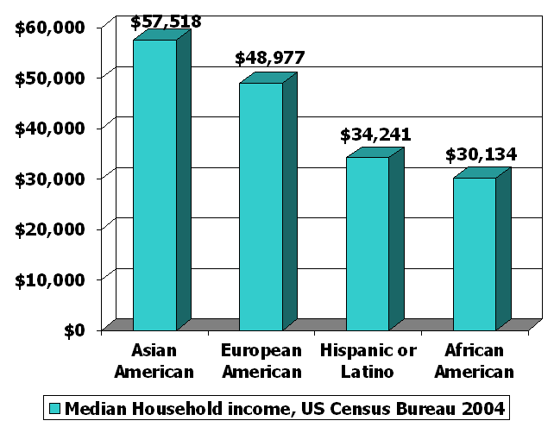
Economic inequality
During the 1990s, the number of American households worth $1 million or more quadrupled to more than 8 million, or 1 in 14 households
Homeownership increased during the 1990’s with 68% of Americans owning their own home.
1999- top 1/5th of American households earned ½ of all income
Lowest tax bracket’s average income actually declined between the 1970s and the 1990s
Income varies widely by race
High school graduates earn only ½ the income of college graduates
Largest income gap of all industrialized nations is seen in the United States

Slide 39
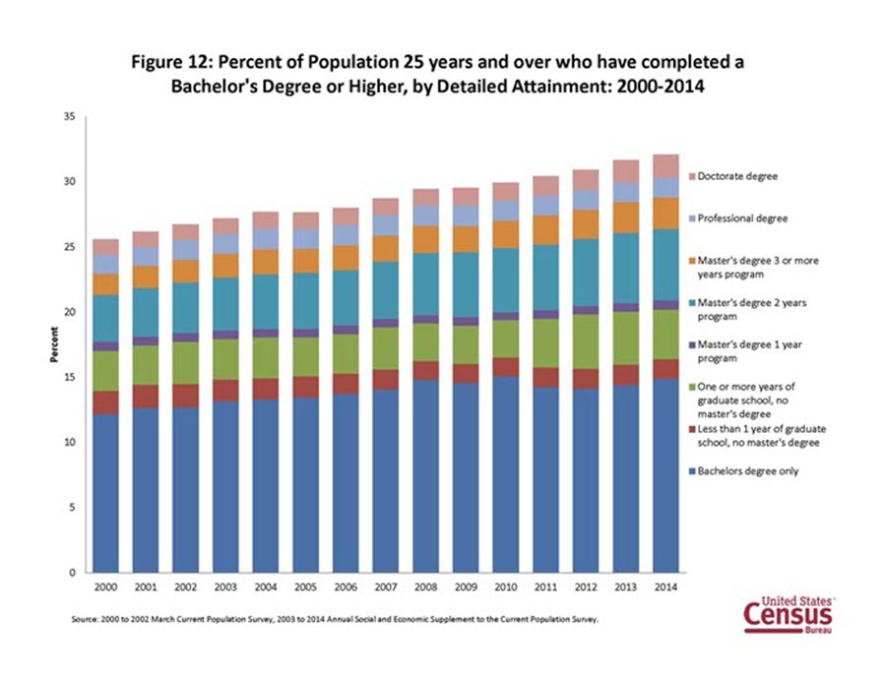

Slide 40
Trade agreements, size of government, and financial system
International trade agreements show that the world is becoming ever more globalization and interdependent
North American Free Trade Agreement (Clinton Admin)
World Trade Organization (WTO) (GW Bush Admin)
G-8 Summit – some of the world’s largest economies’ leaders’ meet (Canada, France, Germany, Italy, Japan, Russia, UK, US) These countries control 2/3 of the world’s wealth
However these countries are soon surpassed by China, India, and Brazil by the 2000s

Slide 41
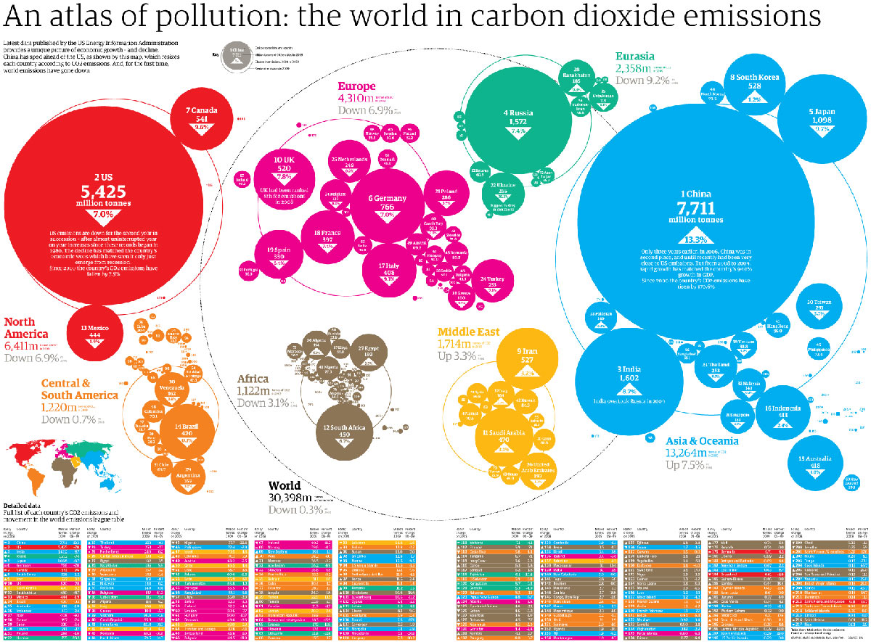
Fossil fuel

Slide 42
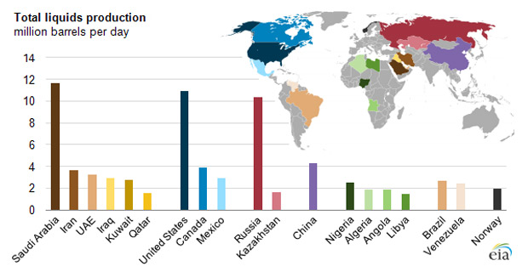
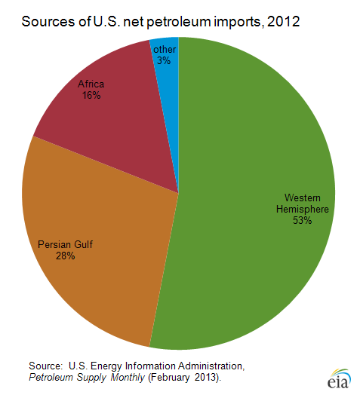
Fossil Fuel
category including crude oil, natural gas liquids, refinery gains and biofuels

Slide 43
.com
The 1990s (Clinton admin) saw the major development (at least to regular American people) of the Internet.
Immediately, the internet changed commerce.
Amazon, who originally only sold books, became a huge success.
Apple will reenter the market place (although keep in mind the iPod doesn’t come out until 2004-ish and the iphone 2007-ish
This was significant for the US because for years the US had faced heavy competition from Europe and Asia, and now American business became more effective as they cut costs.
During the .com boom unemployment fell from 7.5 to 3.9% (a 30 year low)
Peak of internet prosperity was from 1997-1999 but 2001 saw the .com bubble burst and the US fell into a recession

Slide 44
Key Concept 9.3, II
C) Conflicts in the Middle East and concerns about climate change led to debates over U.S. dependence on fossil fuels and the impact of economic consumption on the environment.
D) Despite economic and foreign policy challenges, the United States continued as the world’s leading superpower in the 21st century.

Slide 45
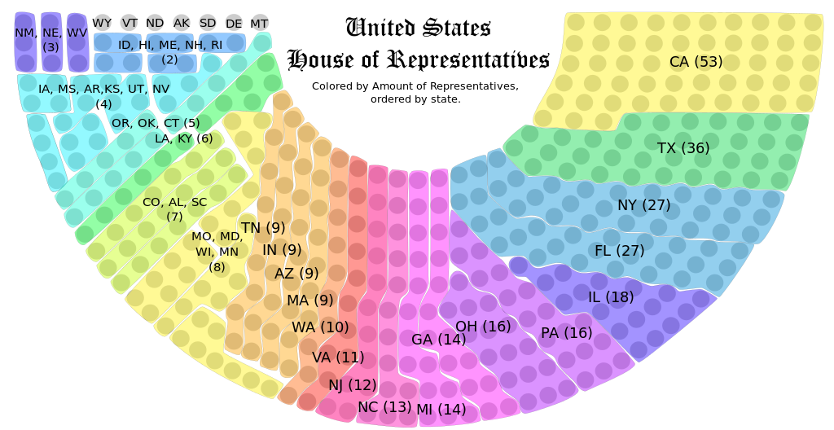
American south and west
In 2000, US population was 281.4 million (3rd highest)
Growing regions of the South and West giving these areas greater political power and influence
This was seen with a major redistribution of congressional members to western and southern states, where north and eastern states lost seats in the House
Today’s Congressional districts in House

Slide 46
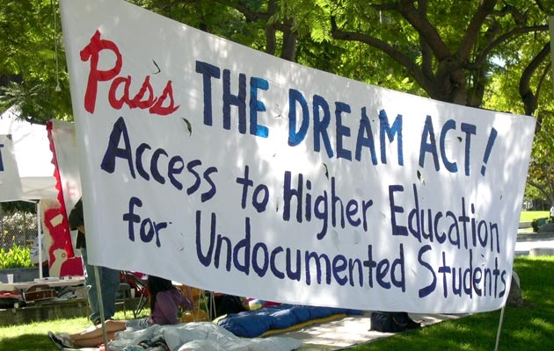
Immigrants and Migrants
Migrants
Immigrants
Debates for immigrants and some internal migrants: immigration reform?
DREAM Act – yet to pass; but exists in TX
Increased border security??
Immigration Platforms for 2016?
In 2000 Census shows 30% of Americans lived in cities, 50% in suburbs, and 20% rural
Immigration Reform and Control Act of 1986 – tried to create a fair process for immigrants from Mexico but couldn’t stop illegal immigration from Mexico
2000 – Hispanics marked the fasted growing population in the US and the largest minority group
Asian Americans also growing quickly in 2000 and represented 10% of the population
2004-10.4% of Americans were foreign born; immigration counted for 28% of population increase

Slide 47
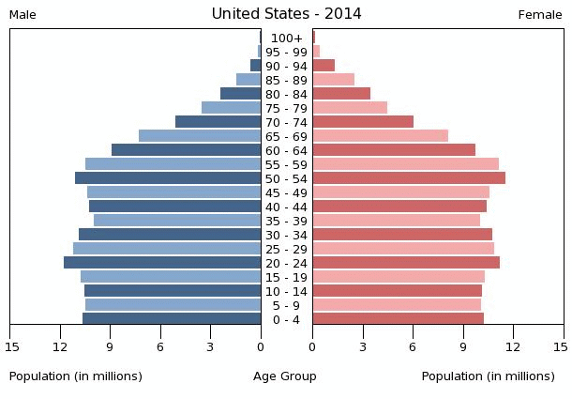
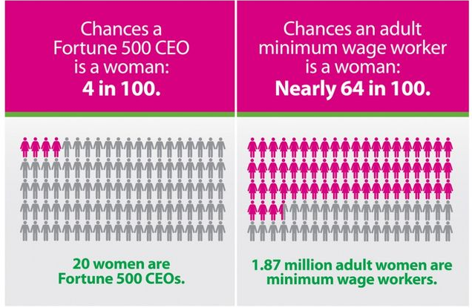
Demographic changes
Age/Makeup of Family
By 2000, 35 million people were over 65, but fastest growing segment of the US population was 85+ as boomers age
Growing concerns regarding health care, prescription drugs, senior housing, and Social Security
Estimated that by 2030 there will only be about 2 workers for each person receiving Social Security
Decline of ‘traditional’ families:
# of females heading a family went from 5.5 million in 1970 to 12.8 million in 2000
Single women headed 47.2% of African American families in 2000, trend also seen in Hispanic families with kids under 18
Children in these families often grow up in poverty without adequate support

Slide 48
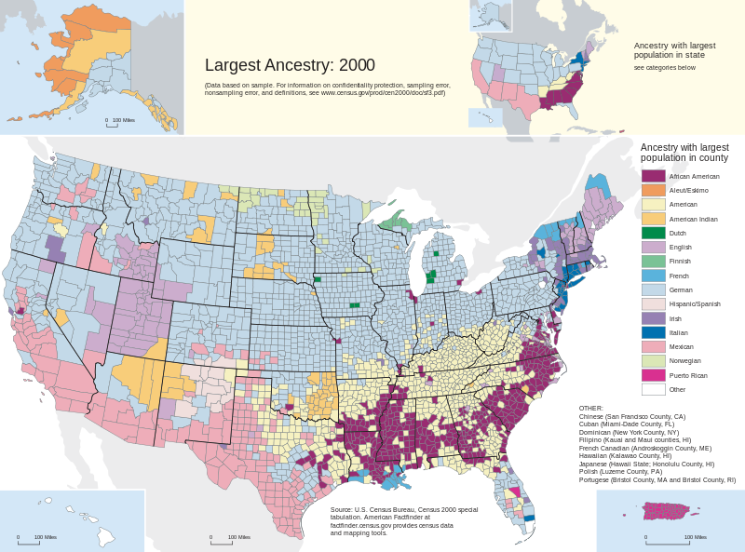
Demographic Changes

Slide 49
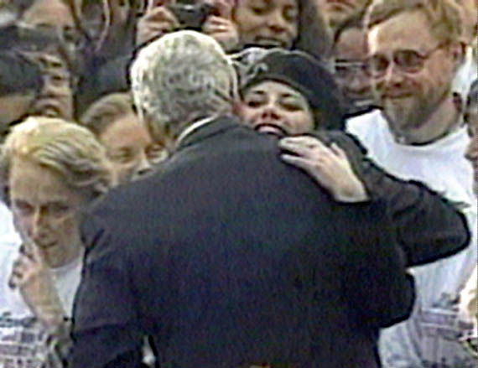
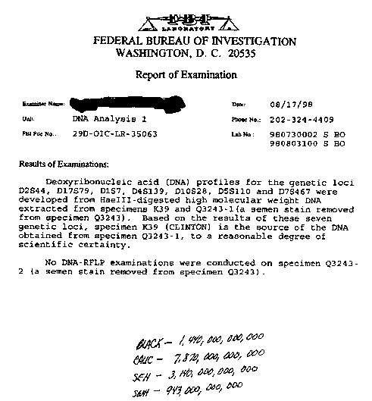
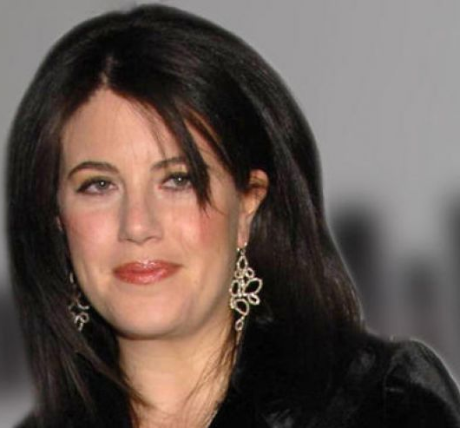
Other late 90s stuff…
Clinton Impeachment
Investigations began around other issues (Whitewater (real estate investments of the Clinton’s privately), Travelgate, and Filegate) but Kenneth Starr charged Clinton with a sexual harassment suit while he was the governor of Arkansas, and that he lied about inappropriate relationships with a White House Intern
Did not get the 2/3 majority needed for impeachment in the Senate and finished his term in office
Gave an interesting Ted Talk just a few months ago on the media and public shaming

Slide 50
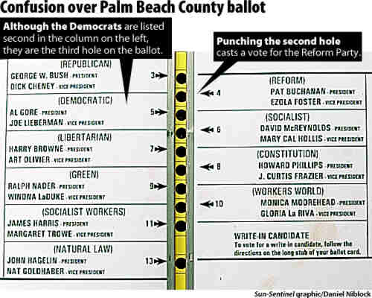
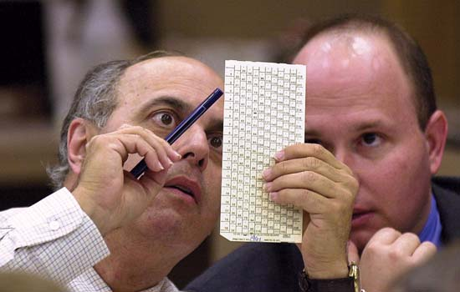
Other late 90s stuff…
Bush v. Gore
VP Al Gore challenges GW Bush for the presidency in 2000
Contentious election was too close to call
Came down to FL “recounts”
Supreme Court was asked if Gore could continue to challenge the vote counting of the state, the court said ‘no’ essentially naming Bush as president (5-4 decision, completely aligned with parties). Court said recount would violate the 14th Amendment
Gore had ½ million more popular votes than bush did nation wide
Bush led in FL by 537 votes…from old people…who couldn’t punch through their papers

Slide 52
II. Following the attacks of September 11, 2001, U.S. foreign policy efforts focused on fighting terrorism around the world.
A) In the wake of attacks on the World Trade Center and the Pentagon, the United States launched military efforts against terrorism and lengthy, controversial conflicts in Afghanistan and Iraq.
B) The war on terrorism sought to improve security within the United States but also raised questions about the protection of civil liberties and human rights.

Slide 53
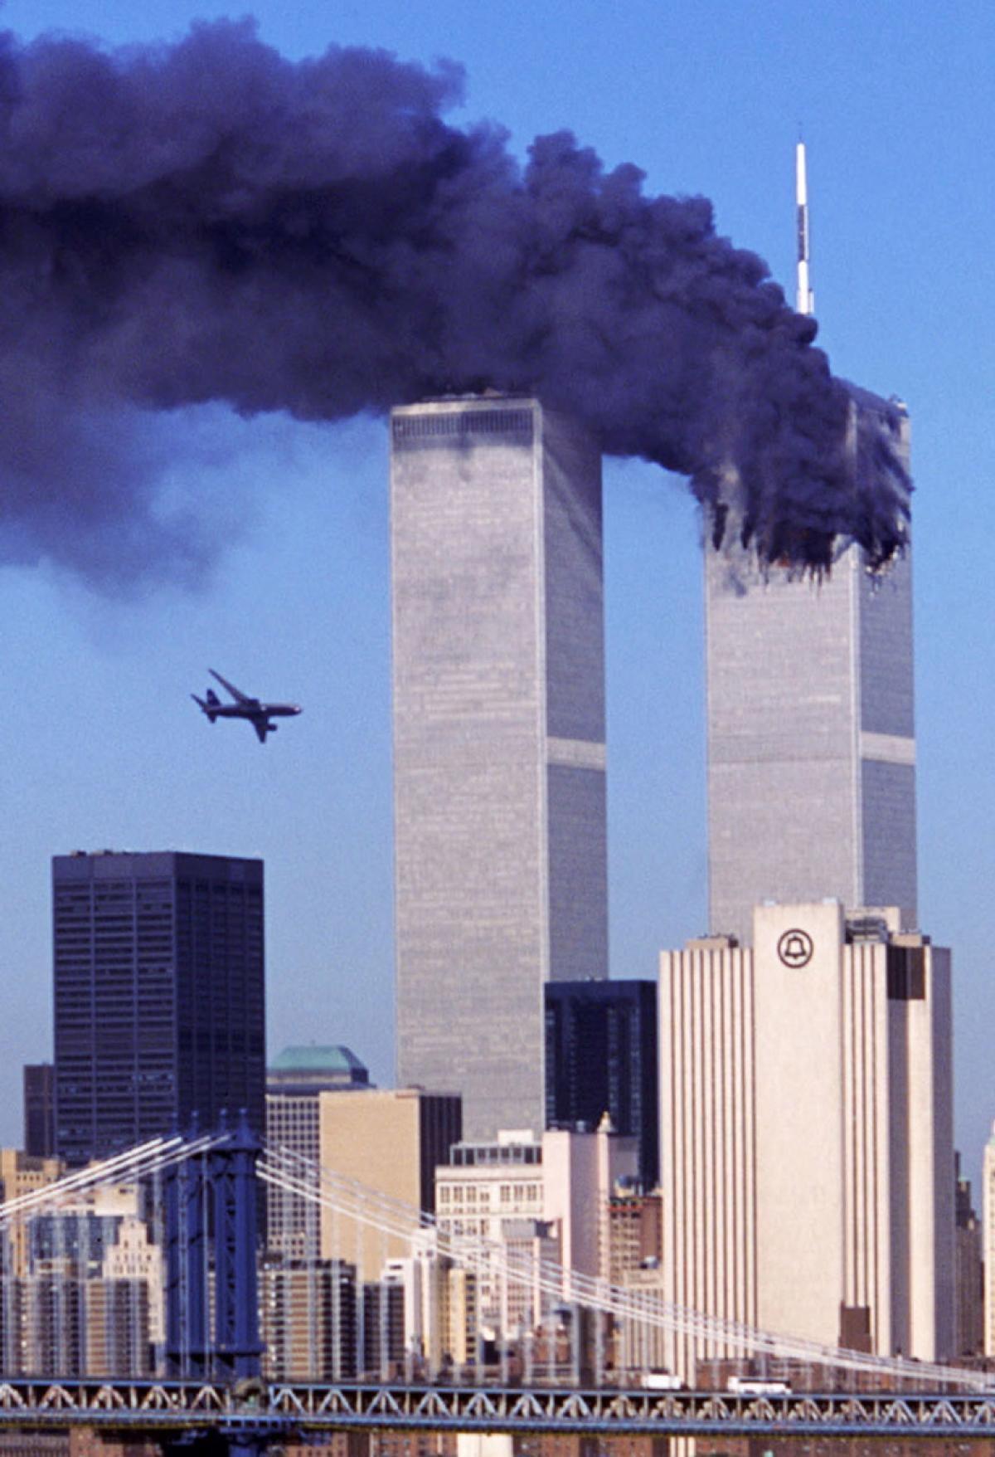
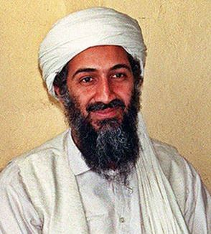
9/11/2001
9/11 Attacks orchestrated by al-Qaedea (led by bin Laden) and specifically planned by Khalid Sheikh Mohammed for extremist ideological, religious purposes

Slide 54
From the commander in chief’s perspective…
By this point, you should see a pattern emerging with wartime power…wars are often initially supported, people are willing to forgo some civil liberties, and there is usually a ‘rally around the flag’ mentality.
However, this often dwindles as the war drags on, just as it did with the conflicts in Iraq and Afghanistan.
‘bull horn’ speech – ground zero
9/14/2001

Slide 55
Civil Liberties and Human Rights
Civil Liberties
Human Rights
USA PATRIOT Act – Uniting and Strengthening American by Providing Appropriate Tools Required to Intercept and Obstruct Terrorism Act (Passed by Congress, signed by Bush on 10/26/2011
Some parts extended by Obama, May 2011
Title 1: Funds counter-terrorism - $$$
Title II: Surveillance – most controversial – allows us to ‘increase surveillance’ on people suspected of terrorism or computer fraud/abuse
Title III: Money Laundering to prevent terrorism
Title IV: Border Security
Title V: Removing obstacles to investigating terrorism
Title VI: Victims of Families of Terrorism
Title VII: Increase info sharing
Title VIII: Terrorism and Criminal Law
Title IX: Improved Intelligence
Titile X: Misc
Black sites
Interrogation techniques
Guantanamo Bay
Hate crimes/prejudice against Muslim Americans

Slide 56
US Military Intervention in the Global War on Terror (GWoT)
War in Afghanistan
Iraq War/Operation Iraqi Freedom
Searching for bin Laden, US troops overthrow fight the Taliban in Afghanistan and chase to the Afghanistan/Pakistan border (bin Laden eventually caught in Operation Neptune: Pakistan May 2, 2011)
Bush calls Iran, Iraq, and North Kora an “axis of evil” in his 2002 SOTU address
No known link between Saddam Hussein and 9/11; concerns over WMD’s to terrorists
Preemptive attack on Saddam, after Bush tells UN that Iraq didn’t follow UN resolutions
No WMD’s found
Capturing of Saddam Hussein in 2003 but continued violence in Iraq

Slide 57
Obama and Beyond
2008 Election
Since 2008
Support for Obama surges as the looming economic crisis becomes voters #1 concern, passing War on Terror
Continued gridlock in Congress
The Great Recession (2008-2015??)
Economic Stimulus and ‘bailouts’
Affordable Care Act
Without hindsight, impossible to know what is/will be historically significant

Slide 58
2016: Who’s next???

Slide 59
Period 9 Timeline
http://ap.gilderlehrman.org/period/9
Republican
1980-1988
Republican
1988-1992
Republican
2000-2008
Democrat
1992-2000
(although passes Don’t Ask Don’t Tell and Has a balanced budget, passes welfare reform and repeals Glass-Steagall Act)
Create a timeline of period 9 events…don’t let this thematic ppt or the thematic framework fool you

